Slide 1
Part 2
Design concept
&
Engineering analysis

Slide 2
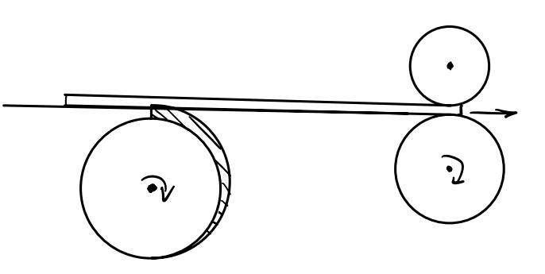
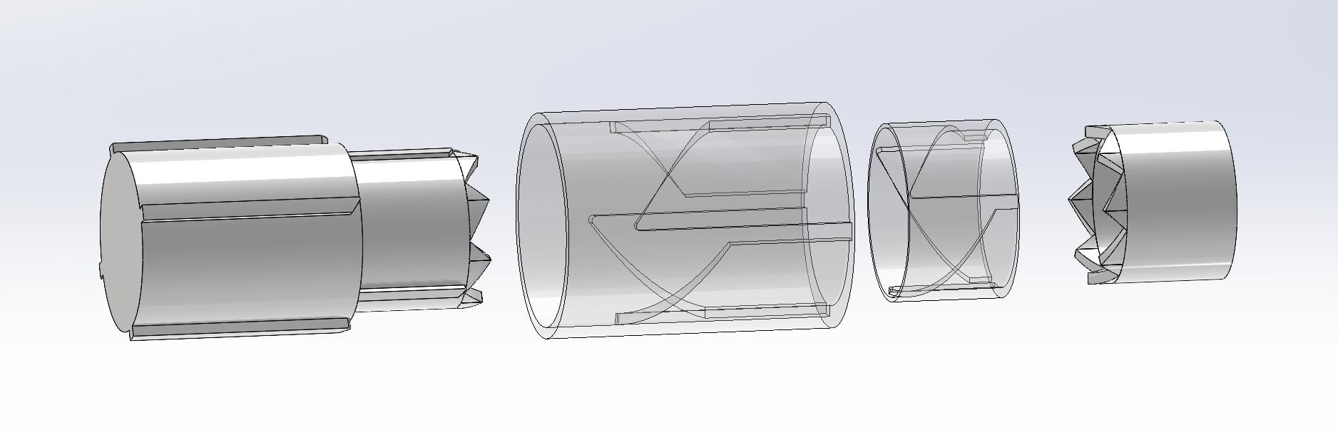
Design concept
Two parts
Rotation parts
Delivering parts
Rotate 90° / 120° each turn (Rotating Design)
Outer shell
Choose either 3 or 4 players
(Chooser)
Deliver cards
Give card an initial speed

Slide 3
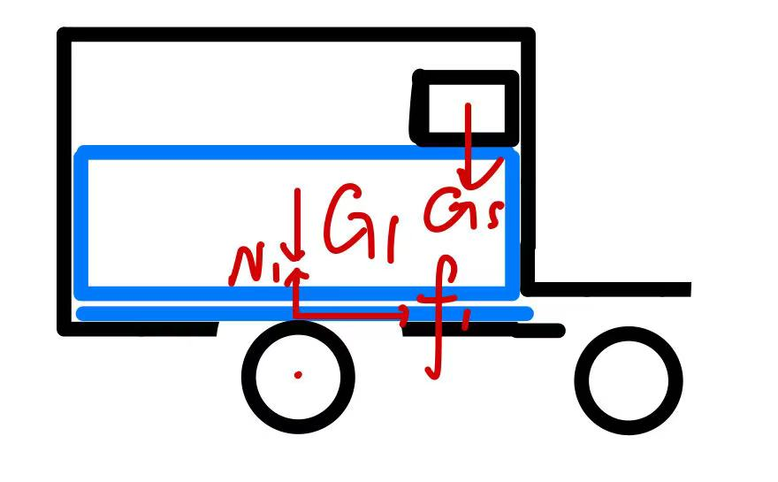
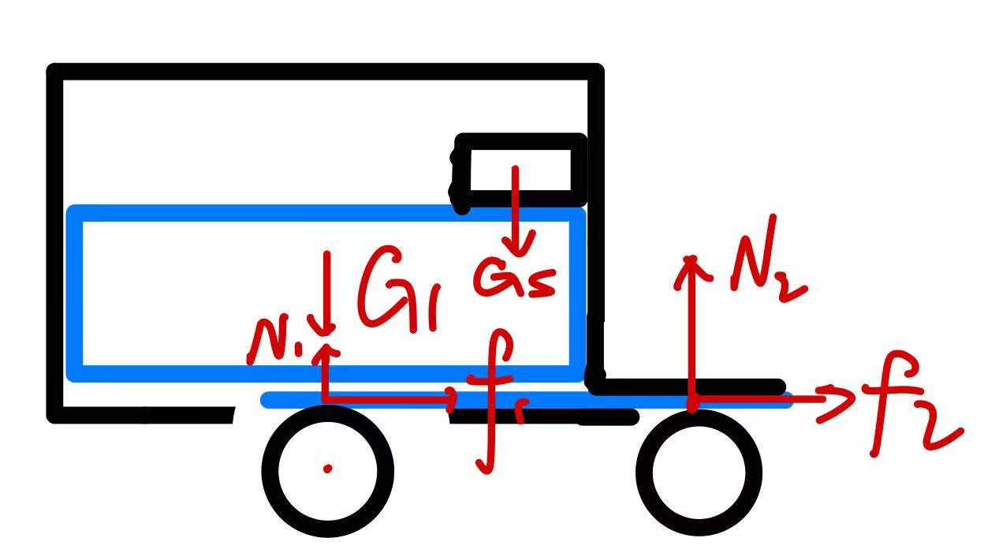
Design concept explanation & Force analysis
Delivering parts
Weight stack
Card

Slide 4
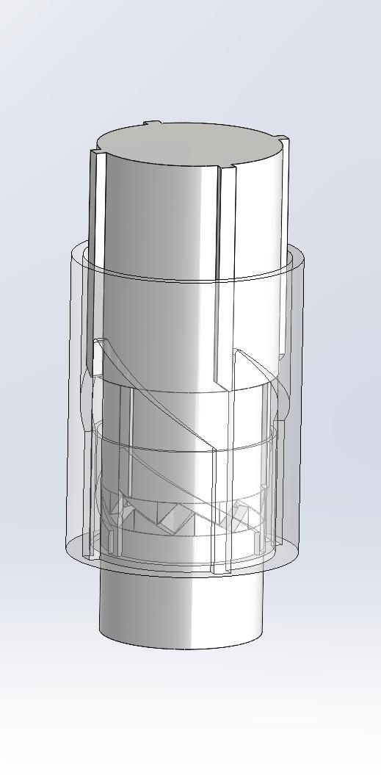
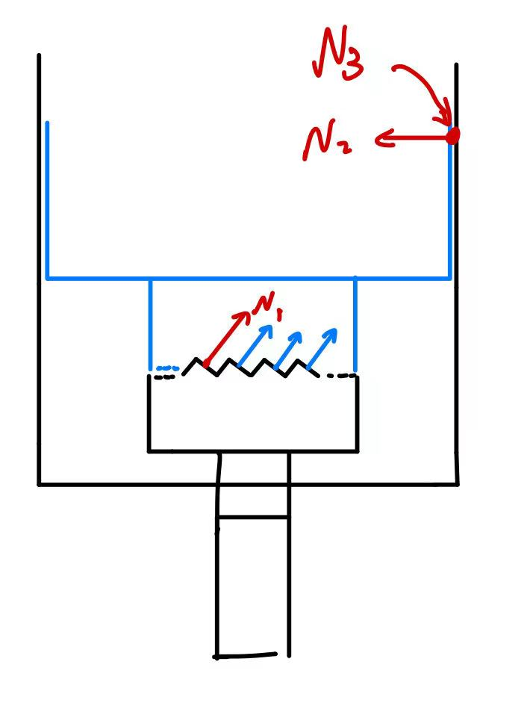
Design concept explanation & Force analysis
Rotation parts
Bottom parts (During delivering)
Middle parts
Outer shell
Rotating design
Bottom parts
Vertical linear motor

Slide 5
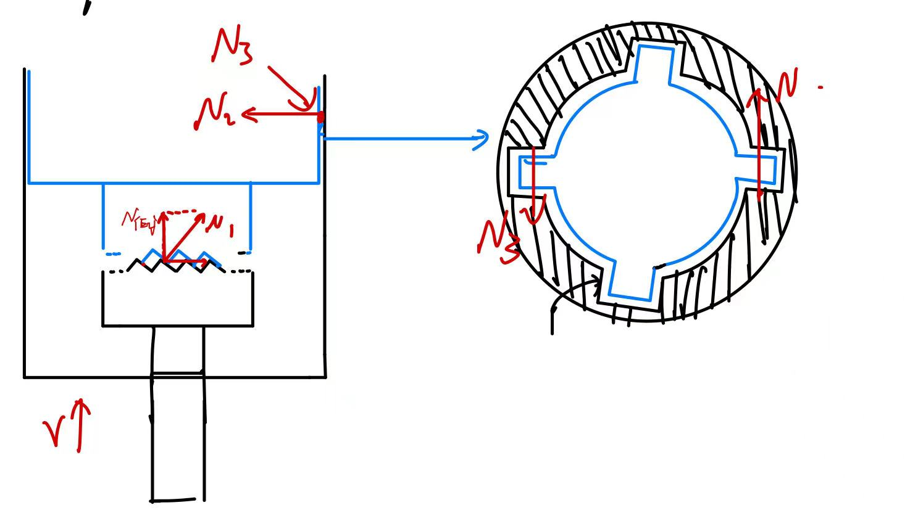
Design concept explanation & Force analysis
Rotation parts
Bottom parts (During Lifting)
Top view
Sinks in the outer shell
For four players 4 sinks 1 round
Vertical linear motor lifts up

Slide 6
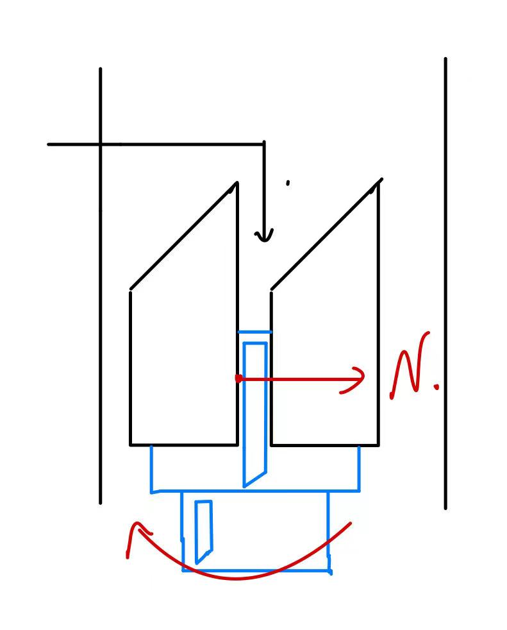
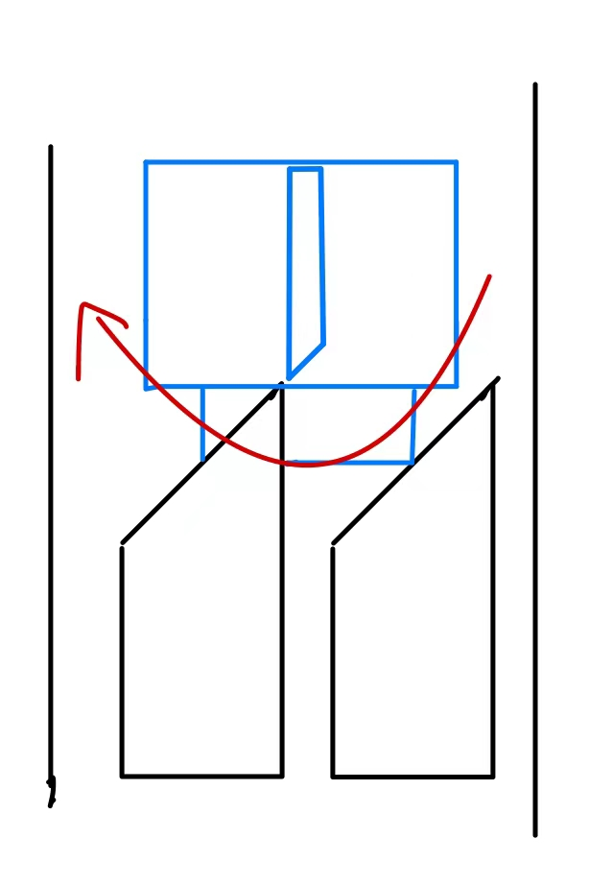
Design concept explanation & Force analysis
Rotation parts
Middle parts (During Lifting)
The inside composition of the shell
Rotating to another sink
Lifting to the top
Potential moving tendency

Slide 7
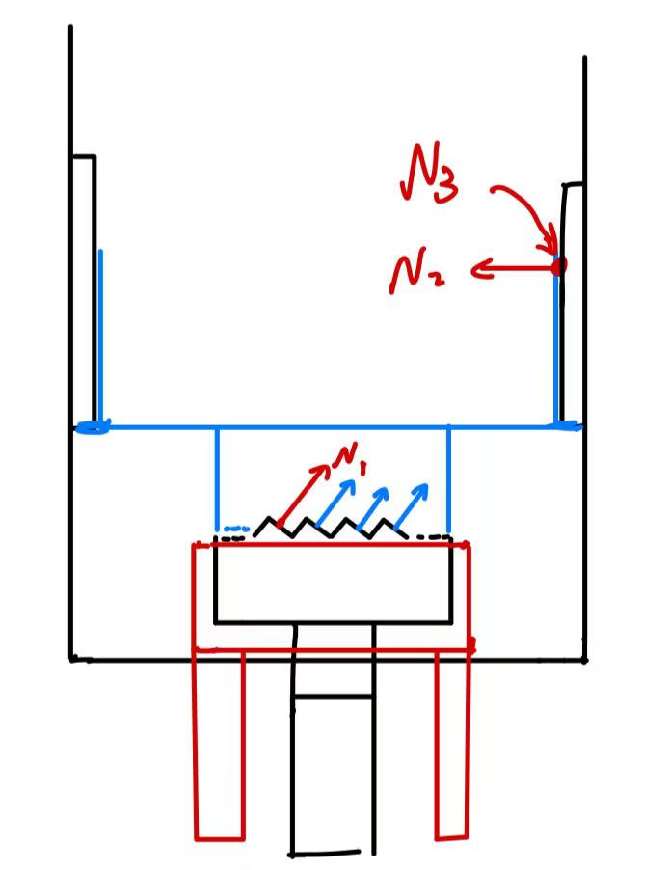
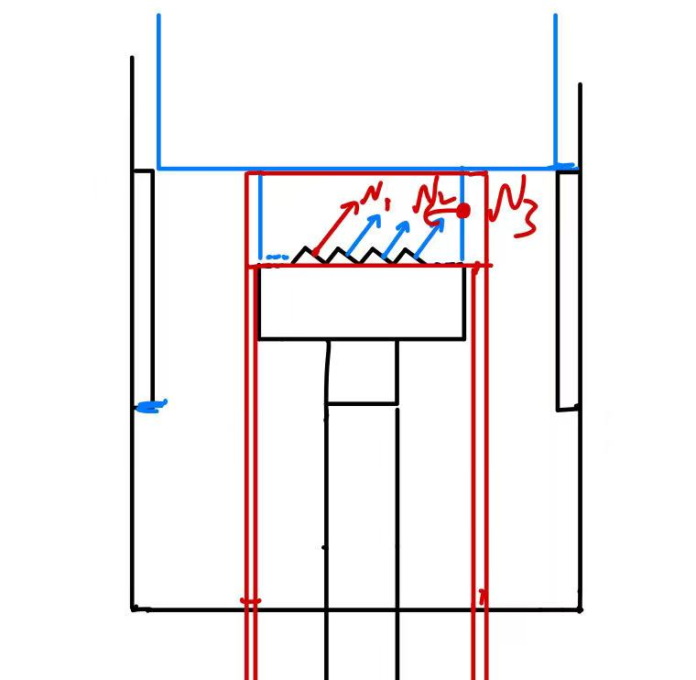
Design concept explanation & Force analysis
Rotation parts
Middle parts (During Lifting)
Get out of sinks in the outer shell
Visualized
Sink of the shell
Similar sinks but 3 sinks a round
(for 3 players)
Chooser
Supporters
Lifted up
2 supporters controlled by Arduino

